Slide 1



GIT / GITHUB FUNDAMENTALS
Get started with Git / GitHub

Slide 2
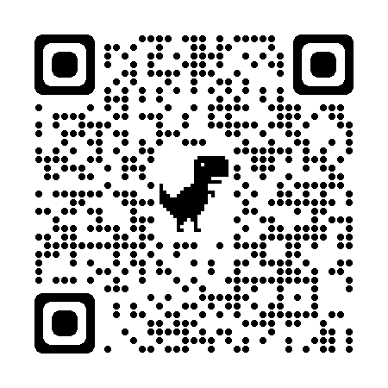
Scan QR code here…
Or access
https://my-contact-info.vercel.app/

Slide 3

AGENDA
1
Git / GitHub Overview
2
Git Repository - Recording Changes
3
Basic Git Commands
4
Working with GitHub

Slide 4
GIT / GITHUB OVERVIEW

Slide 5



Git / Github Overview
Distributed Version Control System (DVCS)
Track changes
Collaborate
Notes:
Distributed Version Control System vs. Centralized Version Control System

Slide 6


Git / Github Overview
Provides a cloud-based Git repository hosting service

Slide 7
GIT REPOSITORY
RECORDING CHANGES

Slide 8
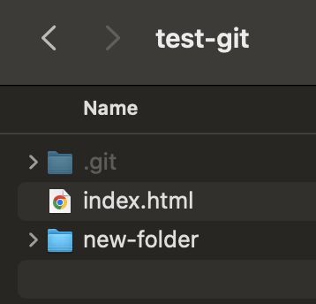
Git Repository - Recording Changes
Project Folder
git init
git clone
Local Repository

Slide 9
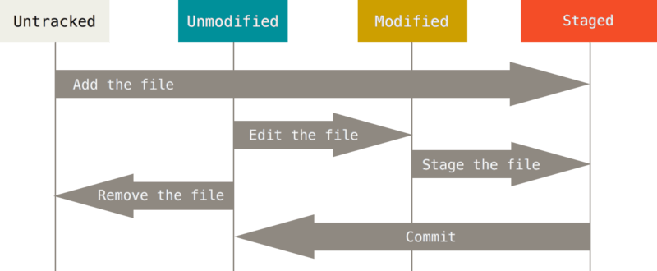
Git Repository - Recording Changes
Tracked
(Git - Recording Changes to the Repository, 2020)
Notes:
What will happen if we edit staged files?

Slide 10
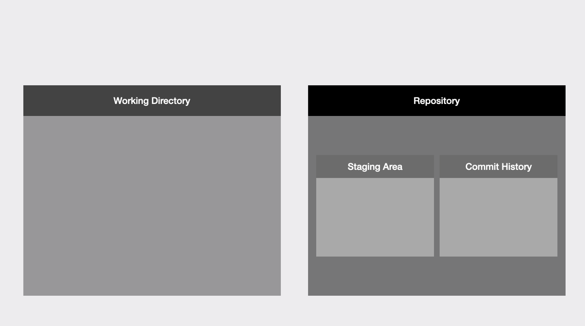
Git Repository - Recording Changes
(Skoulikari, 2021)

Slide 11
BASIC GIT COMMANDS

Slide 12
Basic Git Commands
Scenario 1
Create a new project folder. Add some files to this folder. Initialize a new Git repository. Commit all files in this folder.

Slide 13
Basic Git Commands
Scenario 2
Edit a tracked file A. Create a new file. Send all changes to the staging area. Edit tracked file A again. Resend all changes to the staging area. Commit all changes.

Slide 14
Basic Git Commands
Scenario 3
Untrack a tracked file A. Commit change. Create a .gitignore file, ignoring file A. Edit another file. Commit all changes.

Slide 15
Basic Git Commands
Scenario 4 (part 1)
Create a new branch A from the master branch and check-out this branch. Create new files, edit the tracked file A’, and commit all changes. Create another branch X from the master branch and check-out this branch. Create new files, edit the tracked file A’, and commit all changes. Create another branch Y from the X branch.

Slide 16
Basic Git Commands
Scenario 4 (part 2)
Merge the A branch into the Y branch. Resolve conflicts, commit all changes, and view commit history. Check out the X branch. Rebase the X branch onto the A branch. Resolve conflicts, commit all changes, and view commit history.

Slide 17
Basic Git Commands
Scenario 5
Check out the master branch. Merge branch X (or Y) into it. Delete all other branches.

Slide 18
WORKING WITH GITHUB

Slide 19
Working with GitHub
Scenario 1
Create a new GitHub repository. Push the current local repository to GitHub. Create a new local branch, and push it to the remote repository. Add new files, edit tracked files in this local branch, and commit them. Push all new commits to the remote repository.

Slide 20
Working with GitHub
Scenario 2
Create a pull request on GitHub. Do steps 4 and 5 of scenario 1 again. Review the pull request. Merge the pull request into the main branch. Update the local main branch.

Slide 21
References
Skoulikari, A. (2021, March 17). What is Git? A Beginner’s Guide to Git Version Control. FreeCodeCamp.org; freeCodeCamp.org. https://www.freecodecamp.org/news/what-is-git-learn-git-version-control
Git - Recording Changes to the Repository. (2020). Git-Scm.com. https://git-scm.com/book/en/v2/Git-Basics-Recording-Changes-to-the-Repository
Atlassian. (2023). Merging vs. Rebasing | Atlassian Git Tutorial. Atlassian. https://www.atlassian.com/git/tutorials/merging-vs-rebasing

Slide 22




Q&A

Slide 23




Thank You!

